Slide 1


Visualising Business Models Series: Levels of Work
How to create an organogram for your business
Notes:
"Hello and welcome to BKNC. I’m the guy between the Keyboard and the Chair!
We are going to continue our Visualising Business Models Series. This video is going to be creating an organic organogram using the levels of work framework for your company.
This definitely applies to you if you’re starting a business, but it is also relevant for professionals and leaders who are tasked with organising companies, business units or departments.

Slide 2

Levels of Work
Someone should answer the phone
Step 01
Someone should assemble it
Step 03
Step 04
Someone should make the thing we sold
Get feedback from the customer
Let the customer know it’s on its way
Step 02
We should produce more efficiently
Step 05
Notes:
A levels of work framework is a way to organize your company's tasks and responsibilities into different levels, which can help increase efficiency and clarity within your organization.
By creating a framework that is based on the natural flow of work, you'll be able to create an organizational structure that feels organic and intuitive to your employees.
First, we'll take a look at the different levels of work and how they can be used to create a more efficient and effective organizational structure.
Then, I'll show you how to implement this framework in your own company. So, grab a notebook and a pen and let's get started!"
So, let's get started!
VSM – Stafford Beer
Luc Hoebeke – Making Work Systems Better
Elliot Jacques - Requisite Organisation (coined the phrase midlife crisis) Stratified Systems Theory (Modes for levels of work)
https://ensembleconsultinggroup.com/a-hierarchy-required-by-nature/
work system is defined by Hoebeke as "... a purposeful definition of the real world in which people spend effort in more or less coherent activities for mutually influencing each other and their environment.“
Hoebeke emphatically makes the point that the recursive hierarchy of work domains (with ‘higher’ domains creating viability conditions for ‘lower’ domains) is not a power-driven management hierarchy.

Slide 3


Business Model Canvas
Key
Partners
Key
Activities
Value
Propositions
Customer
Relationships
Customer
Segments
Key
Resources
Channels
Cost Structure
Revenue Streams
Notes:
"Before we dive into the levels of work framework, I want to remind you of the business model canvas or BMC.
I did a video about the BMC; if you want to watch that click over here to go to that video.
The BMC is a tool that helps companies understand and visualize the different parts of their business, including the value proposition, or unique selling proposition.... the USP.
The unique selling proposition is the part of the business model canvas that describes what makes your company different from others in the market.
In this video, we'll be drawing from the USP to help us create a levels of work framework that is tailored to your company's specific needs.
By understanding your unique selling proposition, you'll be able to create a framework that aligns with your company's mission and values.
This will not only make the levels of work framework more effective, but it will also make it easier for your employees to understand and buy into.
So, before we begin, take a moment to grab your unique selling proposition from your Business Model Canvas.
"

Slide 4
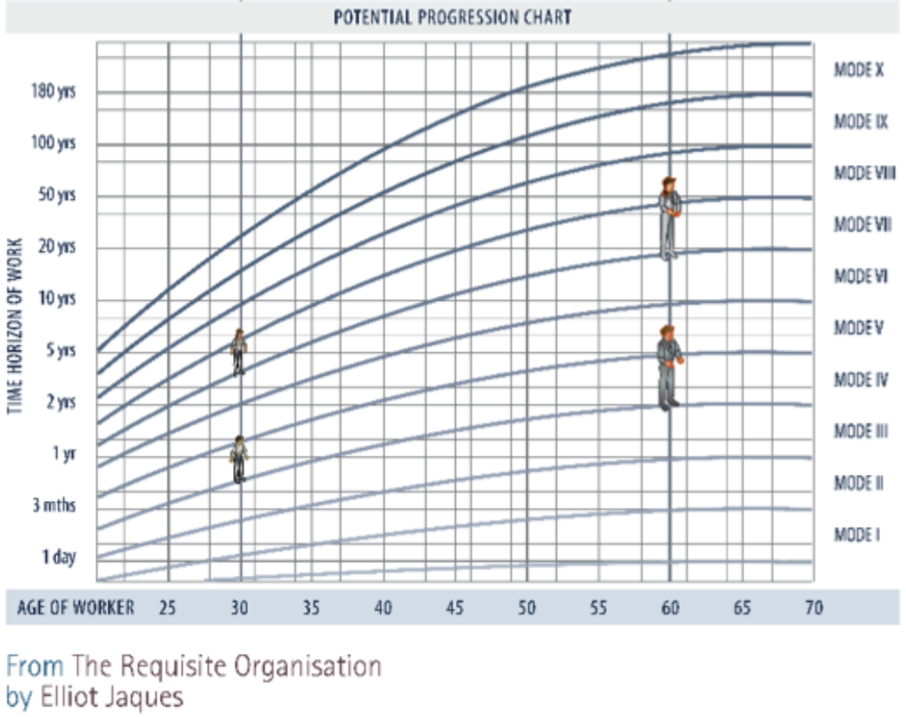



Notes:
Hoebeke emphatically makes the point that the recursive hierarchy of work domains (with ‘higher’ domains creating viability conditions for ‘lower’ domains) is not a power-driven management hierarchy.
"A complete levels of work framework can have as many as 5 or even 6 levels, but for the purpose of this video, we're going to focus on 4 levels. This will be sufficient to produce a complete organogram for your company.
This framework is based on the work of Luc Hoebeke, Elliot Jacques, and Stafford Beer. These experts have developed a way of organizing work into different levels to increase efficiency and clarity within the organization.

Slide 5
Levels of Work
Principles Level
culture
Policy Level
Level 6
boundaries
Strategic Value
Level 5
decide
Controlling Value
Level 4
control
Coordinating Value
supervise
Level 3
Added Value
do
Level 2
Level 1
Notes:
The first level in our framework is L1, also known as the Added Value Level. This level is where the work is done that directly creates value for the customer. This is the level where the product or service is actually produced.
The second level is L2, also known as the Coordinating Value Level. This level is responsible for coordinating the work done at L1 to ensure that it aligns with the overall goals of the company.
The third level is L3, also known as the Controlling Value Level. This level is responsible for controlling the work done at L1 and L2, to ensure that it is being done correctly and efficiently.
The fourth level is L4, also known as the Strategic Value Level. This level is responsible for making strategic decisions for the company, such as setting goals and making plans for the future.
We will not be diving into L5, The Policy level and L6, The Guiding principles level in this video but it's important to note that these levels are also part of a complete levels of work framework.
By understanding these different levels and their responsibilities, you'll be able to create a framework that aligns with your company's mission and values. It will also help you to better understand how the different parts of your company fit together and how they can work together to create a more efficient and effective organization."

Slide 6
Unique Selling Proposition
“Exact height and weight furniture in under a week!”
USP 1
Customer Measurements
USP 2
USP 3
Making Furniture
Same Week Delivery
Level 1
Level 1
Level 1
Level 2
Level 2
Level 2
Level 3
Level 3
Level 3
Level 4
Level 4
Level 4
Notes:
In the BMC video, we used a furniture company as an example to complete together. Let’s continue with that example.
So our value proposition was summarized in our slogan as “Exact height and weight furniture in under a week”.
This means we need to ensure we focus on our unique selling proposition of customer measurements; making furniture and delivery in one week.
You will see that our levels of work framework now has these USPs as columns that will cut across all the levels.
Let’s populate L1 together

Slide 7



Level 1 - Can output value
Customer Measurements
Furniture Making
Same Week Delivery
Customer Measurer (App)
Children Furniture Maker
Delivery Van Driver
Family Furniture Maker
3rd Space Furniture Maker
Regional Storage Facilities
On-Site Assembler
Employee Count = 4
I deliver and
I assemble
Notes:
To make it easier to understand, I've displayed our unique propositions or USPs as columns that cut through all the levels of the levels of work framework.
Starting with the first USP, Customer Measurements.
At L1, the Added Value Level, the key activity for this USP is the customer measurer app.
This app allows customers to input their measurements and create a custom furniture piece that fits their specific needs.
Moving on to the second USP, Furniture Making.
At L1, the key activities for this USP include:
Children's furniture making
Family furniture making
3rd space furniture making
Each of these key activities is responsible for creating a specific type of furniture that aligns with the company's unique proposition.
Lastly, for the third USP, Same Week Delivery.
At L1, the key activities for this USP include:
Delivery van driving
Regional storage
On-site assembly
Each of these activities is responsible for ensuring that the furniture is delivered to the customer within the same week.

Slide 8
LOW (Levels of Work) Chart
Customer Measurements
Furniture Making
Same Week Delivery
P1
P1
P2
?
P3
?
P4
?
P1
Make Children Furniture
?
P3
?
P4
?
Delivery Vans
P2
?
P3
?
P4
?
Measurement Guides Based on Height Weight and Age
P2
Regional Storage Facilities
Assembly On-Site
Make Family Furniture
Make 3rd Space Furniture
Customer Measuring App
Can output value
Coordinates value
Controls value
Sets policy
Notes:
By understanding these key activities and how they align with the company's unique proposition, you can start to see how the different parts of the company fit together and how they can work together to create a more efficient and effective organization.
In the next part of this video, we'll continue to build on this example by looking at how the key activities at L1 align with the coordinating, controlling and strategic value levels. Let’s go and populate L2

Slide 9

Level 2 – Coordinates Value
Customer Measurements
Furniture Making
Same Week Delivery
Raw Materials Supervisor
Orders Manager
App Developer
Inventory Manager
Furniture Assembler
App Store Availability Manager
Employee Count = plus 3 = 7
I’m a developer
I supervise
I take and fulfil orders
By P1
Notes:
"Welcome back, in the last video we discussed the key activities at the L1 level of the levels of work framework and how they align with the unique proposition of our furniture making company.
Now, let's move on to the second level, L2, The Coordinating Value Level. This level is responsible for coordinating the work done at L1 to ensure that it aligns with the overall goals of the company.
For the Customer Measurement USP, the key activities at L2 include:
App store availability management
App development
These activities are responsible for ensuring that the customer measurer app is available for customers to use and for developing and updating the app as needed.
For the Furniture Making USP, the key activity at L2 is raw materials supervision. This activity is responsible for ensuring that the company has the necessary raw materials to produce the furniture and that they are of the highest quality.
Lastly, for the Same Week Delivery USP, the key activities at L2 include:
Orders management
Inventory management
Furniture assembly management

Slide 10
LOW (Levels of Work) Chart
Customer Measurements
Furniture Making
Same Week Delivery
Raw Materials Supervisor
P2
Orders Manager
?
P2
App Developer
Inventory Manager
Furniture Assembler
App Store Availability Manager
P2
P3
?
P4
P1
Delivery Van Driver
Regional Storage Facilities
On-Site Assembler
P3
?
P4
?
P1
Children Furniture Maker
Family Furniture Maker
3rd Space Furniture Maker
P3
?
P4
?
P1
Customer Measurer (App)
Notes:
Each of these activities is responsible for coordinating the delivery process and ensuring that it is done efficiently and effectively.
By understanding the key activities at L2 and how they align with the unique proposition of the company, you can see how the different parts of the company work together to create a more efficient and effective organization.
In the next part, we'll continue to build on this example by looking at how the key activities at L2 align with the controlling and strategic value levels. Let’s populate L3

Slide 11
Level 33 – Controls Value
Customer Measurements
Furniture Making
Same Week Delivery
App Store Budget Controller
Raw Materials Budget Controller
Sales and Profitability Assurer
Development Environment Manager
Storage Facilties Payment Controller
Assembling Budget Controller
Employee Count = plus 2 = 9
I’m the accountant
I price and upsell
By P2
Notes:
"Welcome back, in the last video we discussed the key activities at the L2 level of the levels of work framework and how they align with the unique proposition of our furniture making company.
Now, let's move on to the third level, L3, The Controlling Value Level. This level is responsible for controlling the work done at L1 and L2, to ensure that it is being done correctly and efficiently.
For the Customer Measurement USP, the key activities at L3 include:
App store budget control
Development environment management
These activities are responsible for ensuring that the budget for the customer measurer app is being used effectively and that the development environment is optimized for maximum efficiency.
For the Furniture Making USP, the key activity at L3 is raw materials budget control. This activity is responsible for ensuring that the company is using its budget for raw materials effectively and efficiently.
Lastly, for the Same Week Delivery USP, the key activities at L3 include:
Sales and profitability assurance
Storage facilities payment control
Assembly budget control

Slide 12
LOW (Levels of Work) Chart
Customer Measurements
Furniture Making
Same Week Delivery
P1
P1
Customer Measurer (App)
P2
App Store Availability Manager
P3
App Store Budget Controller
P4
?
P1
Children Furniture Maker
Raw Materials Supervisor
P3
Raw Materials Budget Controller
P4
?
Delivery Van Driver
P2
Orders Manager
P3
Sales and Profitability Assurer
P4
?
Family Furniture Maker
3rd Space Furniture Maker
P2
Regional Storage Facilities
On-Site Assembler
App Developer
Inventory Manager
Furniture Assembler
Development Environment Manager
Storage Facilties Payment Controller
Assembling Budget Controller
Notes:
Each of these activities is responsible for controlling the delivery process and ensuring that it is done efficiently and effectively while also ensuring the profitability of the company
By understanding the key activities at L3 and how they align with the unique proposition of the company, you can see how the different parts of the company work together to create a more efficient and effective organization while ensuring profitability.
In the last part of this video, we'll continue to build on this example by looking at how the key activities at L3 align with the strategic value level. Let’s populate L4"

Slide 13
Level 4 – Decides Value
Customer Measurements
Furniture Making
Same Week Delivery
App Store Policy Maker
Furniture Catalogue Creator
Leads Generator
Development Designer
Market Appetite/Pulse Measurer
Competition Analyser
Sales and Profitability Assurer
Delayed Payments Collector
Lease and Consignment Negotiator
Delivery Van Designer
Employee Count = plus 3 = 12
I’m a co-founder
By P3
I’m a marketer
I cold-call
I’m a service provider
Notes:
"Welcome back, in the last video we discussed the key activities at the L3 level of the levels of work framework and how they align with the unique proposition of our furniture making company.
Now, let's move on to the fourth and final level, L4, The Strategic Value Level. This level is responsible for making strategic decisions for the company, such as setting goals and making plans for the future.
For the Customer Measurement USP, the key activities at L4 include:
App store policy management
Development design
These activities are responsible for ensuring that the company's app store policies align with its goals and that the design of the customer measurer app aligns with the company's vision for the future.
For the Furniture Making USP, the key activities at L4 include:
Furniture Catalogue Creation
Market Appetite/Pulse Measurements
Competition analysis
Each of these activities is responsible for creating a strategy for the company's furniture making business by creating a catalogue of the furniture, monitoring the market appetite, and analyzing the competition.
Lastly, for the Same Week Delivery USP, the key activities at L4 include:
Leads Generation
Sales and Profitability Assurance again
Delayed Payments Collection
Lease and Consignment Negotiation
Delivery Van Design
Each of these activities is responsible for creating a strategy for the company's delivery business by generating leads, ensuring profitability, collecting delayed payments, negotiating leases and consignments and designing the delivery vans.

Slide 14
Our Levels of Work
Customer Measurements
Furniture Making
Same Week Delivery
P1
P1
Customer Measurer (App)
P2
App Store Availability Manager
P3
App Store Budget Controller
P4
App Store Policy Maker
P1
Children Furniture Maker
Raw Materials Supervisor
P3
Raw Materials Budget Controller
P4
Furniture Catalogue Creator
Delivery Van Driver
P2
Orders Manager
P3
Sales Manager
P4
Leads Generator
Family Furniture Maker
3rd Space Furniture Maker
P2
Regional Storage Facilities
On-Site Assembler
App Developer
Inventory Manager
Furniture Assembler
Development Environment Manager
Storage Facilities Payment Controller
Assembling Budget Controller
Development Designer
Market Appetite/Pulse Measurer
Competition Analyser
Sales and Profitability Assurer
Delayed Payments Collector
Lease and Consignment Negotiator
Delivery Van Designer
Notes:
By understanding the key activities at L4 and how they align with the unique proposition of the company,
Now, you can see how the different parts of the company work together to create a more efficient and effective organization while ensuring profitability and aligning with the company's vision for the future.
Now we can synthesize this organic organizational structure.

Slide 15
Our Organogram
CEO (co-founder)
Sales Director
Financial Director (Vacant)
Debt Collection Agency
Marketing Manager
Operations Director (Vacant)
App Developer and Designer
Raw Materials Supervisor
Orders and Inventory Manager
Children Furniture Maker
Family Furniture Maker
3rd Space Furniture Maker
Delivery Van Driver
Accountant
Sales and Profitability Assurer
Notes:
Here it is, our organizational structure
Thank you for watching and I hope you've found this information helpful. We've covered the basics of creating a levels of work framework and how it can be used to create an organic organizational structure for your company. I hope this information will help you to improve the efficiency and effectiveness of your own organization."
Like share subscribe

